Slide 1
Installing Linux
Prepare for Linux Installation
Perform the Installation

Slide 2

Topic A: Prepare for Linux Installation
Exam Objectives:
This topic does not cover specific exam syllabus objectives or content examples.

Slide 3
System Requirements
More than just requirements for installation.
Also requirements for continued and reliable operation.
Based on many factors:
  Linux distro being installed.
  Hardware compatibility.
  General category of system.
  Intended function of system.
  Specific apps running on system.
  Price.

Slide 4
Partitioning Strategy
Plan for partitioning storage prior to installation.
Servers have different storage needs than workstations.
If root partition fills up, system will crash.
Home and log file directories can fill up quickly.
Isolate on separate partitions to prevent crashes.
Also plan for swap space partition.
  Necessary for virtual memory storage.
  Usually twice the quantity of RAM.
  Size can vary.

Slide 5
Partitioning Examples (Slide 1 of 2)
Server:
  / as root file system.
  /home to isolate home directory.
  /var to isolate log files.
  Dedicated swap partition.
Workstation:
  / as root file system.
  Dedicated swap partition.

Slide 6
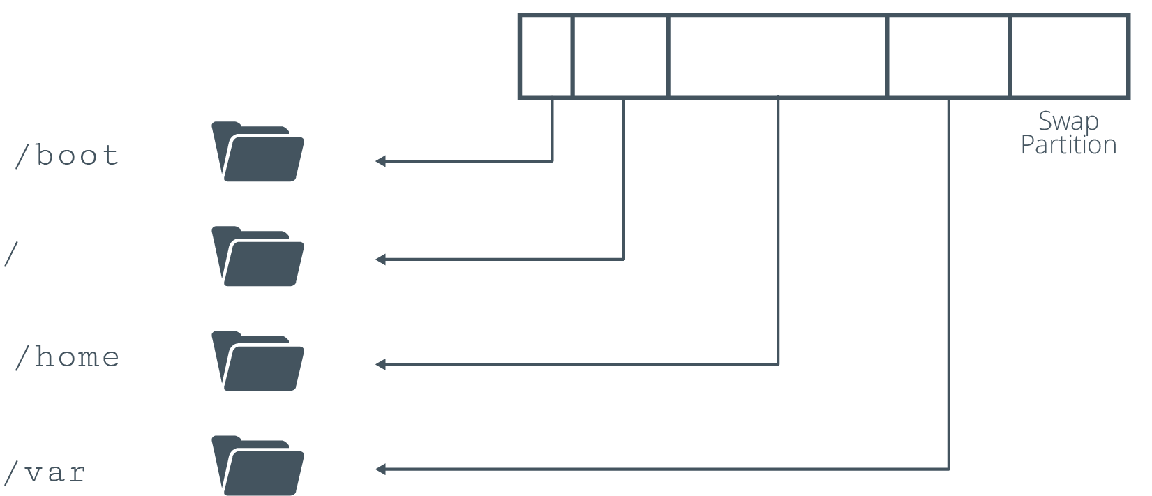
Partitioning Examples (Slide 2 of 2)

Slide 7
Hardware Compatibility
Before purchasing hardware, ensure it is compatible with distro.
If available, check HCL.
  Stores vendors/models that distro supports.
  Usually available online.
  Many distros don't have an official HCL.
Gather hardware info about system.
  Available in documentation that came with components.
  Available in documentation on manufacturer's site.
  Available from BIOS/UEFI.
  Printed on physical component.

Slide 8
Questions to Address When Choosing Hardware
Universal:
  Manufacturer?
  Model?
  Driver support?
Storage drive:
  How many?
  What interface controller technology?
  What capacity?
  Mechanical or solid-state?
  Read/write speeds?
CPU:
  Server or desktop market?
  Clock rate?
  Cache size?
  Physical cores?
  Hyper-threading?
Memory:
  How much?
  Enough DIMM slots?
  Generation of DDR SDRAM?
Network card:
  Technologies supported?
  Maximum bandwidth?
Input device:
  Hotpluggable?
  USB version?
Monitor:
  Connection interface?
  Refresh rate?
  Resolution?
Display adapter:
  Chipset?
  Video RAM?
  Integrated or discrete?
  Connection interface?

Slide 9
Installation Methods
Installing OS requires booting into install environment.
Boot methods you learned earlier can be used to boot installation media.
Boot from DVD/USB:
  Prepare/burn install files (e.g., ISO) to physical media.
  Might need to configure BIOS/UEFI.
Boot from media on local drive:
  Download media to separate partition.
  Configure GRUB 2 to boot from media.
Boot from network:
  PXE/NFS services installation media to clients.
  Clients use media to boot into install environment.

Slide 10
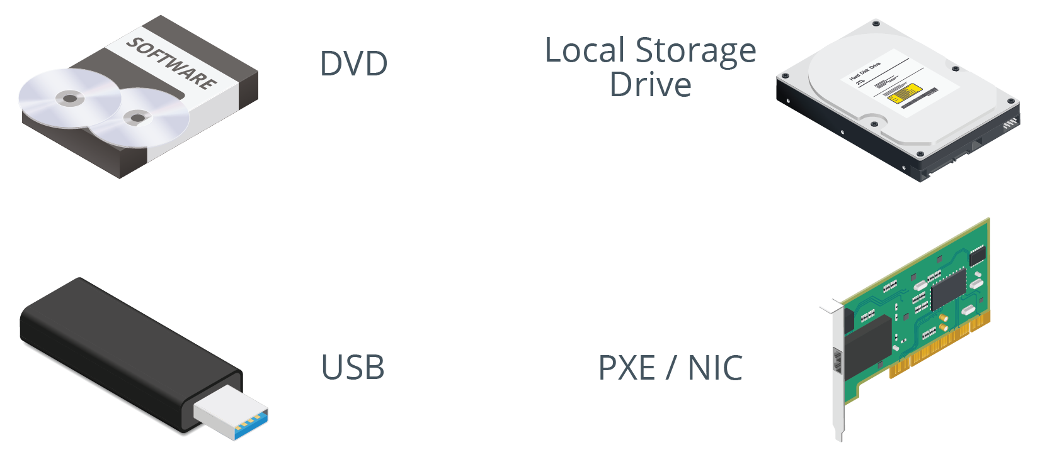
Installation Media

Slide 11
Guidelines for Preparing to Install Linux
Consider the factors that go into identifying system requirements.
Consider partition strategies based on role of Linux system.
Check HCLs or other resources for hardware support.
Address questions pertaining to hardware components.
Choose the optimal installation method for your environment.

Slide 12
Activity: Preparing to Install Linux (Slide 1 of 2)
You need to create Linux systems for different purposes:
  Public-facing web server.
  Desktop environment for graphic designer.
  System for testing custom software.
Choose which hardware to apply to which purpose.
  System A
  System B
  System C
Notes:
Teaching Tip: Encourage students to visit websites such as https://linux-drivers.org/ to check the specifications of the available systems against the current HCL.
Teaching Tip: This activity addresses some common issues that students can encounter in the field, even though the issues might not be encountered on the certification exam. Share your experiences with installation preparation, and encourage students to share their experiences with the rest of the class.

Slide 13
Activity: Preparing to Install Linux (Slide 2 of 2)
System A:
  32 GB RAM
  Quad-core Intel Core i7 processor
  2 TB hard drive
  100 Mb/s Ethernet
  Discrete video card
System B:
  8 GB RAM
  18-core Xeon processor
  500 GB SSD
  1 Gb/s Ethernet
  Onboard graphics adapter
System C:
  4 GB RAM
  Dual-core AMD A6 processor
  250 GB hard drive
  100 Mb/s Ethernet
  Onboard graphics adapter
Notes:
Teaching Tip: This activity is intended to spark discussion and walk students mentally through the process of preparing for installation. The questions draw on information they've learned throughout the course. The answers are suggestions, not definitive recommendations.

Slide 14
Topic B: Perform the Installation
Exam Objectives
This topic does not cover specific exam syllabus objectives or content examples.

Slide 15
Manual Installation Steps (Slide 1 of 3)
Vary depending on distro you're using.
Most installers have a GUI.
Most installers enable configuration of common options.

Slide 16
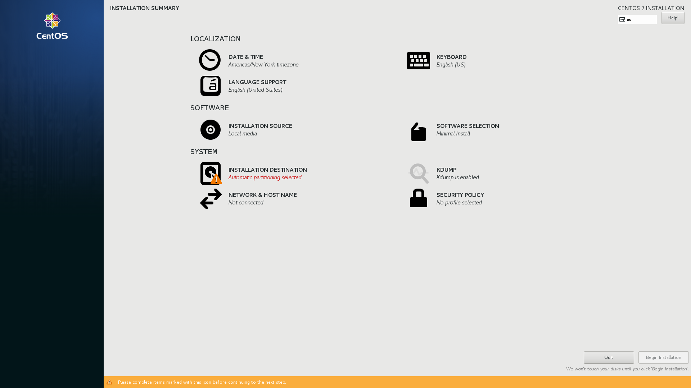
Manual Installation Steps (Slide 2 of 3)

Slide 17
Manual Installation Steps (Slide 3 of 3)
General steps:
  Configure language/layout settings.
  Configure date and time.
  Choose other installation media.
  Choose software environment/components.
  Partition storage drives.
  Configure network identity.
  Configure user accounts.
  Configure security policies.

Slide 18
Discussing Installing Linux

Slide 19
Activity 15-2: Discussing Installing Linux
Depending on the Linux distribution you have chosen to install, which accounts are you prompted to set up during installation?
ANSWER:
  Every distribution prompts for a user account and some prompt for the root password as well. CentOS, for example, prompts for a user account and the root password.

Slide 20
Activity 15-2: Discussing Installing Linux
During installation, you are prompted to set up a system's networking identity. What information is included in a system's networking identity?
ANSWER:
  The hostname, IP address information, and DNS servers. Most networks, especially corporate ones, have DHCP servers that provide the IP address and DNS information.

Slide 21
Activity 15-2: Discussing Installing Linux
On larger networks, installing Linux manually each time is not efficient. How do larger organizations install Linux, if not manually?
ANSWER:
  They use an automated orchestration suite that distributes a pre-configured system image to the hardware.

Slide 22
Activity 15-2: Discussing Installing Linux
You want to manually install Linux on a new laptop that has no DVD drive, and you do not have access to one. How can you install Linux onto the laptop?
ANSWER:
  Download the ISO and use a utility to write the ISO to a USB thumb drive. Then, boot from the thumb drive.

Slide 23
Activity 15-2: Discussing Installing Linux
What are usually the first two pieces of information you are prompted to provide during a Linux installation?
ANSWER:
  You have to select a keyboard layout and system language.

Slide 24
Activity: Installing Linux
You're ready to install Linux.
You'll start by installing CentOS 7 on a VM.
You'll configure various options to set up environment to your specs.
Notes:
Interaction Opportunity: Consider letting the more experienced students know that they can leave if they aren't interested in going through the installation process. Students who are interested can stay and perform the steps in this activity.
Teaching Tip: Time permitting, you may wish to have students install Ubuntu in a VM as well.
Teaching Tip: Remember, if your classroom network is using an IP address range other than 10.50.1.0/24, make sure to inform students.

Slide 25
What Linux distributions do you think you'll install in your organization, or have you installed in the past?
Do you anticipate any hardware compatibility issues in your installations? Why or why not?

